Slide 1
disantideambiguation
Input data source
#r / Key data cols+vals
Processing/script name
.extension/type
Output data file
93293 / p,v,fp,mb
TODO / FIX NEEDED / HOLDUP
#r / Key data cols+vals
Manual processing
.extension/type
Ssh HPC scripting
.extension/type

Slide 2
dataflow
Yf API
C,v
Dr3
.ipynb
Oipmega_post_yf1.csv
93293 / p,v,fp,mb
Dr3
.ipynb
Oip_mega_rounded1.csv
93293 / p,v,fp,mb
Dr3
.ipynb
Your_file_cleaned.csv
93293 / p,v,fp,mb
D3_yf_errors_by_ticker_wdata2.csv
4389 (2000) / ticker error dict
Oip_mega_wreturns.csv
ADD#r / p,v,fp,mb,r
oi_rawpull_ymd_2019_01_01_2025_08_06_incl.csv 93293 / OI data only
Manual data find
~2000
New source col(s)
Oip_mega_wreturns.csv
Yf API
Ohlc->sig
Dr1b+dr2+3.ipynb???
Barchart_ripper.py
Make dynamic/reusable
Auto pull from new sources
O,h,l,c,v
Volget9.py
(drop if p_m1_td na)
Oip_mega_wretvol.csv
recaptured.csv
O,h,l,c,v by ticker
NOTE: ['sig_c_1' 'sig_gk_1' 'sig_gkc_1’] are all blank!
Openinsider.com
Sigma + ret compute, trade-wise slice
Oip_mega_wretvol.csv
73495 / p,v,fp,mb,r,sig
Sp500_ft1.csv
#? / o,h,l,c,v,r
ogmissingtrades.csv
P,v,mb,etc by trade
Merge py
Yf API
^GSPC, SPY
SNP500getter .ipynb
Sp500_ft1.csv
Daily snp metrics Nov1,2018
Needs merge/infill w OG tbh
Oip_mega_filled.csv
~92000? / p,v,fp,mb,sig
Yf API
^GSPC, SPY
morefeatures1 .ipynb
Oip_mega_boost1.csv
73494rows, 4183stocks
+ Purchase_pct_mcap, tradefile_td, ret_trade_to_mebuy
Oip_mega_features.csv
~92000? / p,v,fp,mb,sig,%,normed
~N + log() transforms of distributed ft variables (by ticker? By var? by yr?
Oip_mega_relative.csv
~92000? / p,v,fp,mb,sig,%
Relative weighting of volume, insider buy data by ticker avg/total?– more ft cols
Oip_mega_boost1.csv
Ask GPT stats q:
Which to normalize/log tform etc, and how? across ticker? Across trade lookback? Across all tickers? Across all trades? Give context of strategy/how model is implem/etc
Entry_classifier_make_filter
.py
Dr5_hpcLGBM1
.py
Mdp_trajectory_panel.csv
Entry_filter.csv
Mdp_features_for_value_model.csv
Dr5_infer_policy_fix
.py
Value_model_lgbm.txt
Value_model_features.json
Backtest_policy
.py
Backtest_test_summary.csv
Backtest_test_min060.csv
Sweep_policy_grid
.py
backtest_test_thr062_adaptive20.csv
Naïve_LGB_backtest_table.xlsx
backtest_test_thr50_adaptive20_zoomin.csv
Sweep_policy_grid_fast
.py
sweep_policy_grid_results.csv
sweep_fast_results.csv
stability_adapt40_buf009_thr050_robustness.csv
Pnl_distribution
.py
pnl_dist_adapt40_buf009_thr050_trades.csv
Stability_analysis
.py
stability_adapt40_buf009_thr050_hist.png
pnl_dist_adapt40_buf009_thr050_hist.png
stability_adapt40_buf009_thr050_cumcontrib.png
pnl_dist_adapt40_buf009_thr050_cumcontrib.png
stability_adapt40_buf009_thr050_timeline_top25.csv (trades: 25)
contrastive_top_bottom.py.py
contrast_adapt40_buf009_thr050_logit_l1_coefs.csv (CV AUC ~ 0.599)
stability_adapt40_buf009_thr050_timeline_bottom25.csv (trades: 25)
Stat summary in: contrastivestatsummary_from naiveish adaptive.txt
Augment_value_features
.py
Mdp_features_for_value_model_v2.csv
value_model_features_v2.json
Dr5_infer_policy_fix
.py
Value_model_lgbm_v2.txt
YF API:
ohlcv daily
back to 2018
Oip_mega_boost1.csv
For unique tickers
ipstrong2
.py
Value_model_features_v2.json
Sweep_policy_grid_fast
.py
Sweep_v2_results.csv
Ohlcv_pull
.py
Stonx1/rawdata/TICKER.parquet
Value_model_lgbm_v2_strong.txt
Value_model_features.json
Sweep_policy_grid_fast
.py
Sweep_v2_strong_coarse.csv
Sweep_v2_strong_fine.csv
Sweep_v2_strong_fine2.csv
Monthly_pnl_report
.py
Monthly_v2_strong_buf0085_k30_thr04
Trades.csv equity, (csv/png)
Monthly_pnl_hold5
.py
(intake entry_filter and mdp ft v2)
Naïve_hold5_thr04
Trades.csv equity, (csv/png)
Notes:
Andes to local file port ex: PS C:\Users\John DeForest\Desktop\stonx> scp f00569n@andes.dartmouth.edu:~/stonx1/oip_mega_wretvol.csv .

Slide 3
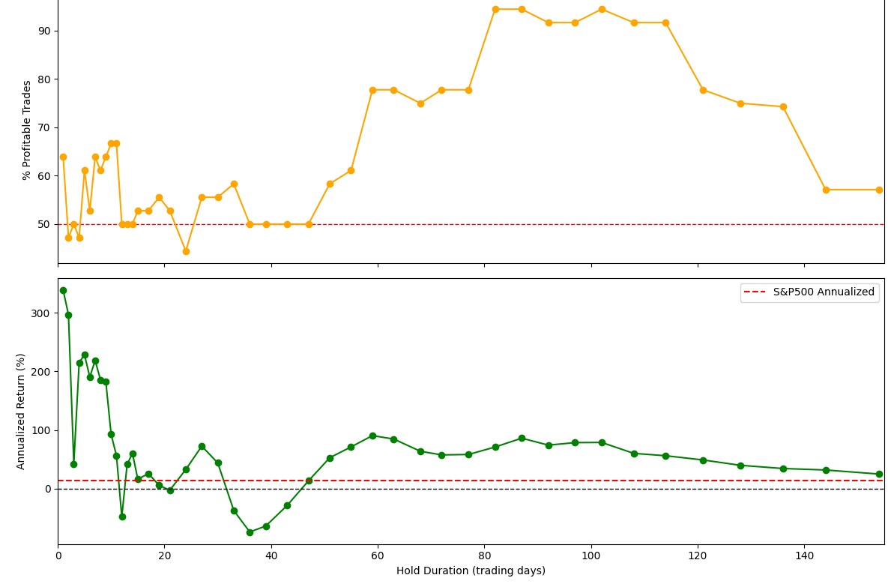
modelflow
Naïve Fixed-Hold_dur
1-150d
Og RF: pred if pos return in next65?
Works ov On some Tickers
1-7 or 45-65 ie MCB ☺
Use hist data by ticker? To pred if fixed hold works? Use insider hist performance?
All neg/0 for ticker for all hold_durs ☹
Look at rolling?
dynamic hold_dur
NO-BUY
Test rolling %win/PnL over time for maxDrawdown
MonteCarlo/Rolling updater
Prob stays Pos/Neg
E[x} fwd pred
(re) Test predicted hold duration PnL (even tho low accuracy, might be directionally/roughly correct?)
Search #hold_duration_multiclass in dr3
Bc tbh I would only count as inaccurate if it ends up NOT positive at the pred hold dur (rather than counting as 0/fail if it isn’t the highest at pred_hold_dur
Within a ticker/class:
Use past working/good (fixed?) hold_dur to inform future insider trade hold_dur?
How to store this data if dynamic hold_dur?
set of for ea prev trade?:
is_pos_hold_dur_under70d? T/F
Hold_dur return curve r vs x
Best hold_dur x
Pred 1d hold VS any+ in 10d hold? 30d?45?70?
Binary AND regression pred.
(obvs both+ daily update Montecarlo)
Test rolling %win/PnL over time for maxDrawdown

Slide 4
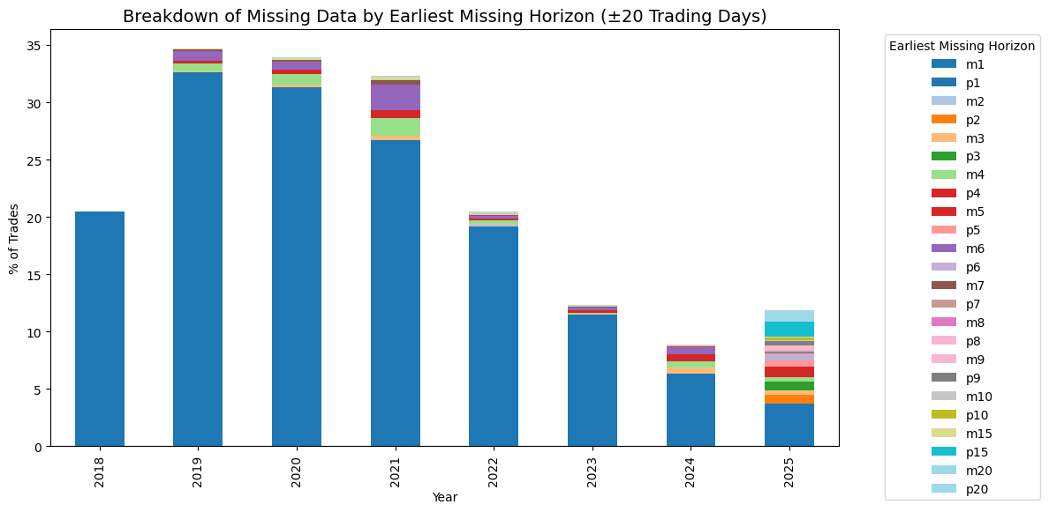
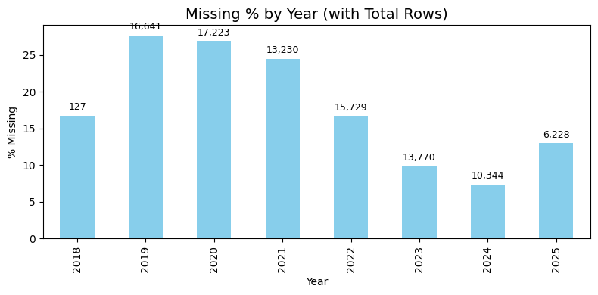
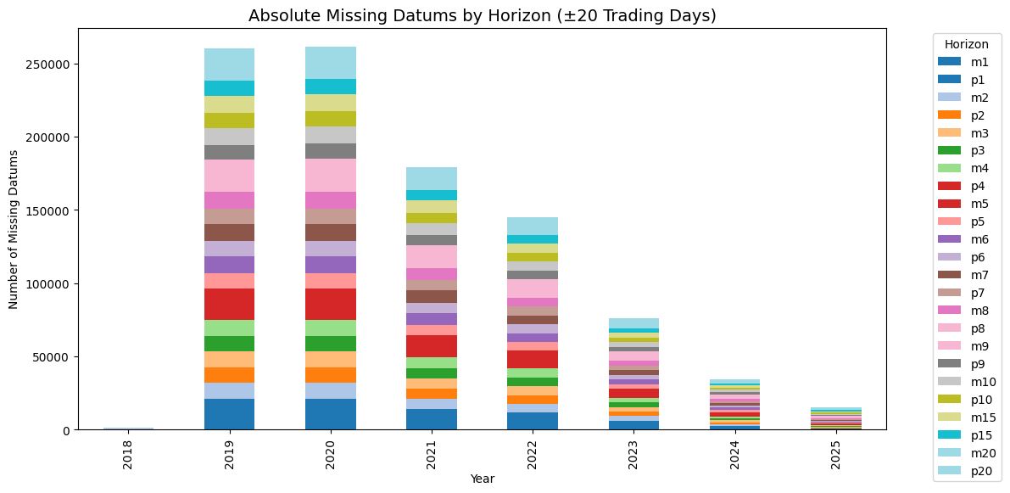
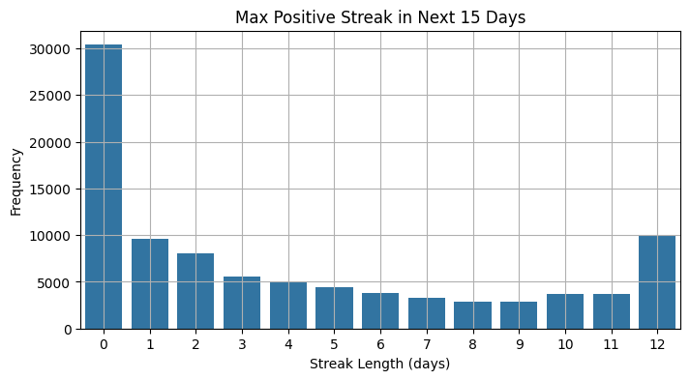
Notings – missing data is often missing for all times, better coverage recently

Slide 5
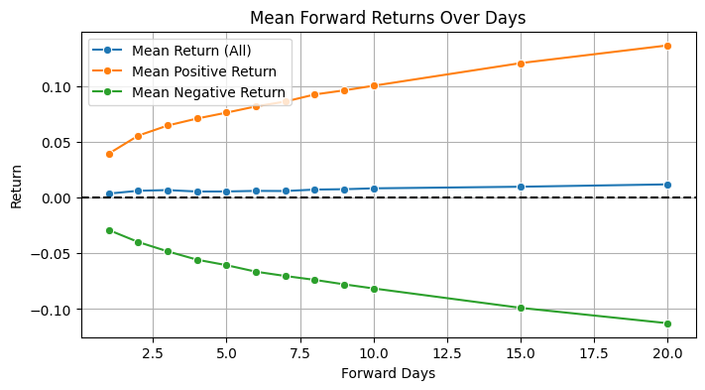
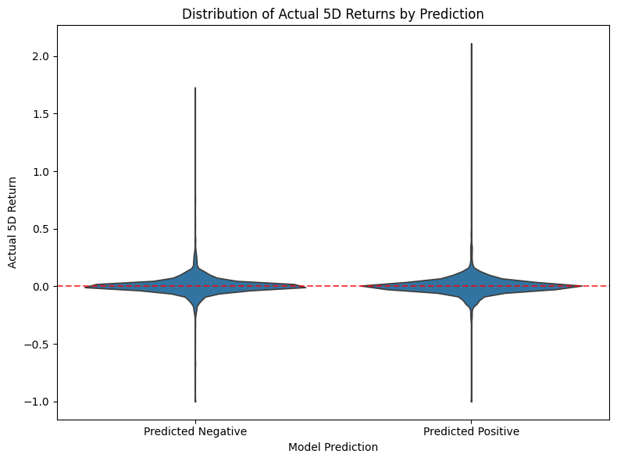
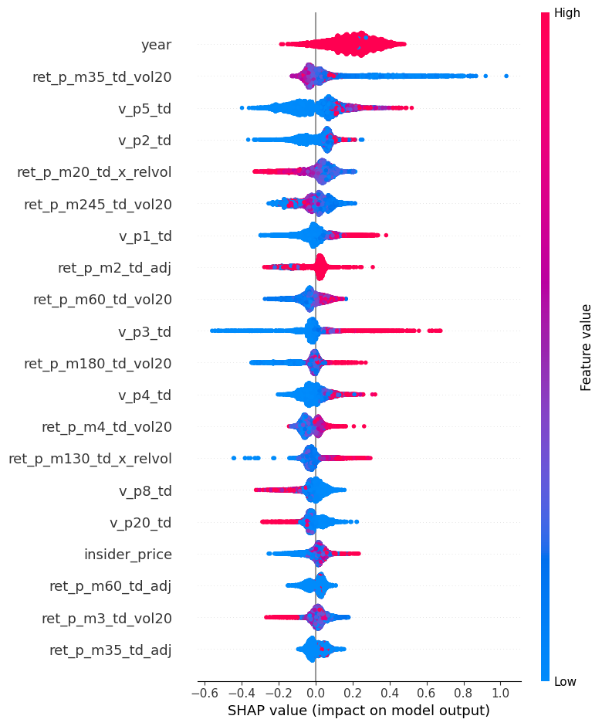
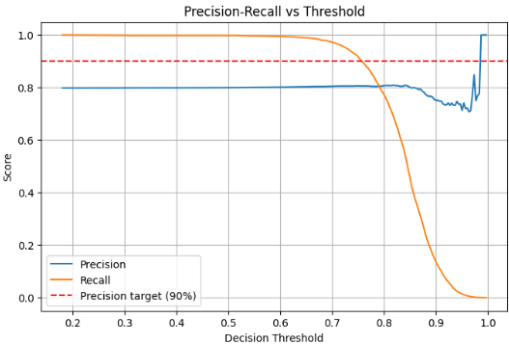
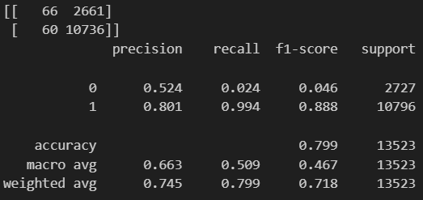
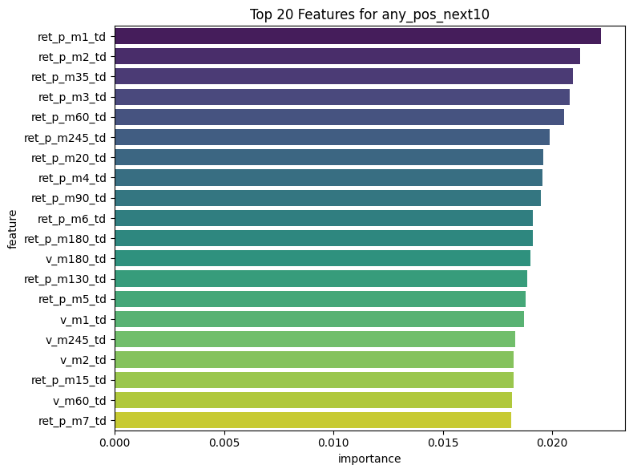

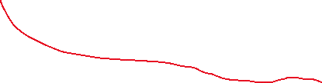

notings2
SHAP takes forever to run, super basic models so far suck, prediction necessary (naïve buying might not work overall)
Basic any+ in next10d:
80% precision @best thresh= 0.6 see below
Dropped 25347r due2 missing lookback data; remaining 67945 rows. Dropped 333 rows due to missing forward ret_p_p1..p10 data; remaining 67612 rows. Number of features after excluding future cols: 64.
(I think this is with 80/20 train/test split)

Slide 6
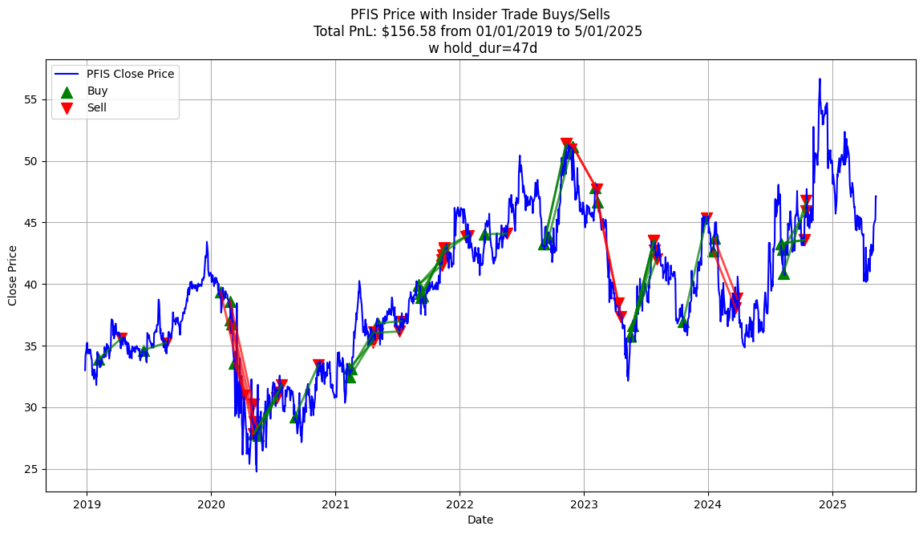
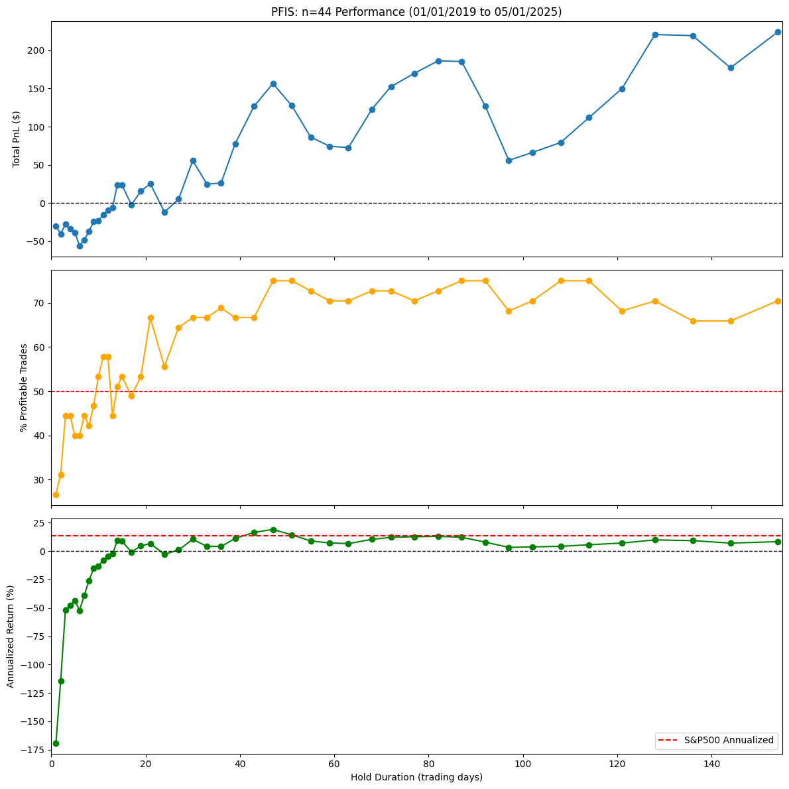
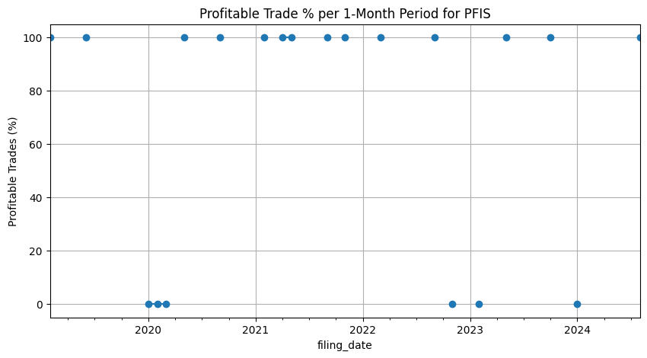
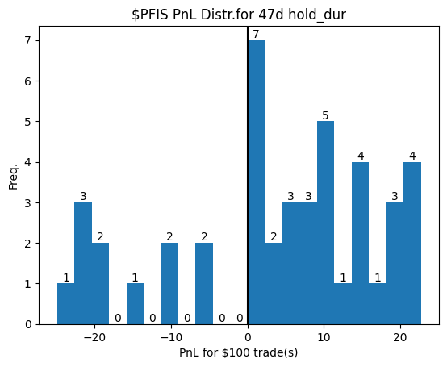
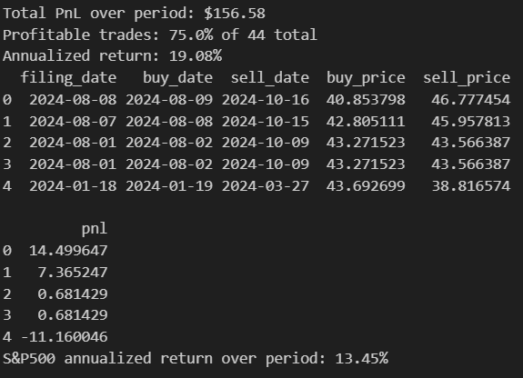
Notings3 – naïve buying testing (baseline)
Iff fixed, hold_dur should be individualized by ticker (classify?)
Ie: $PFIS meh mostly negative (relative to the S&P500)
See next page for posi example tho

Slide 7
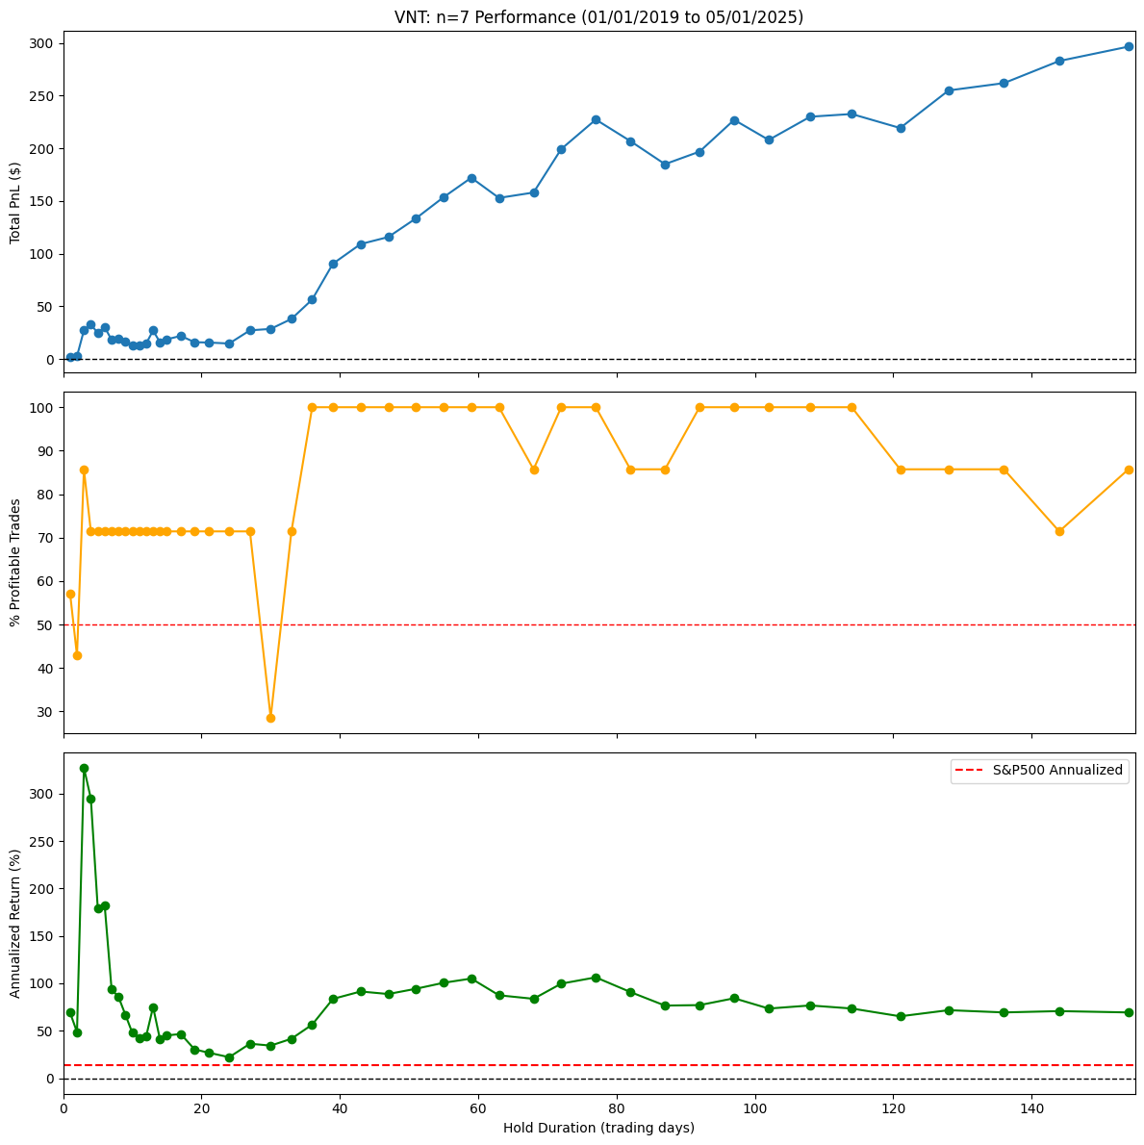
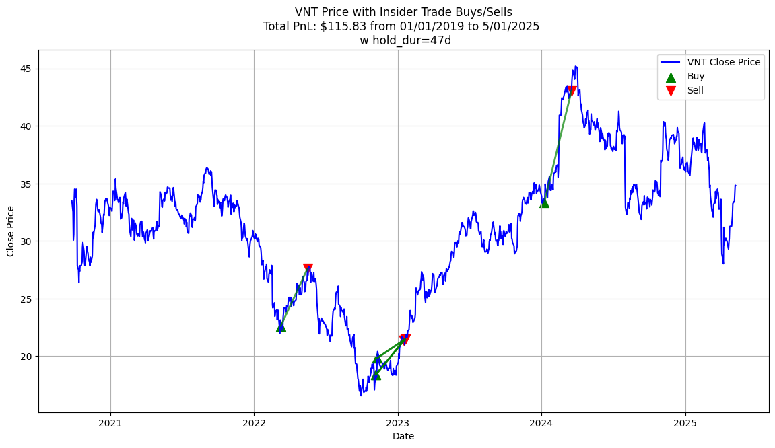
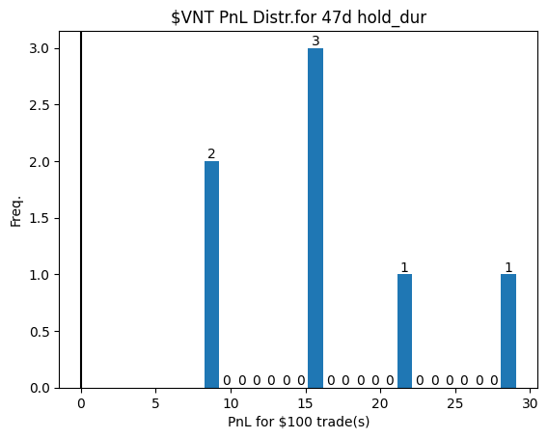
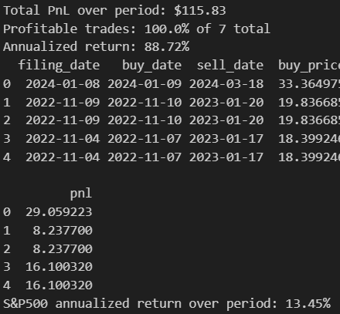
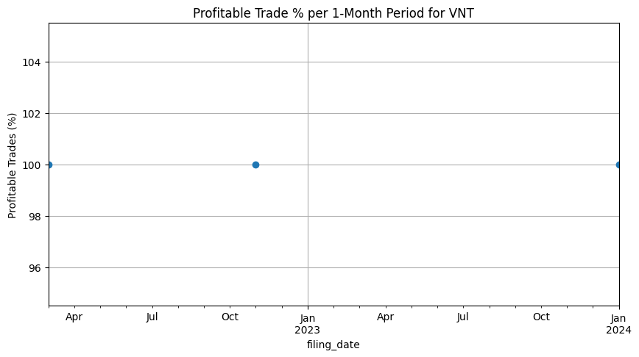



Notings4 – naïve buying cont.
Posi ex of fixed hold_dur: $VNT
45-70 hold_dur region was good for quite a few sampled stocks

Slide 8
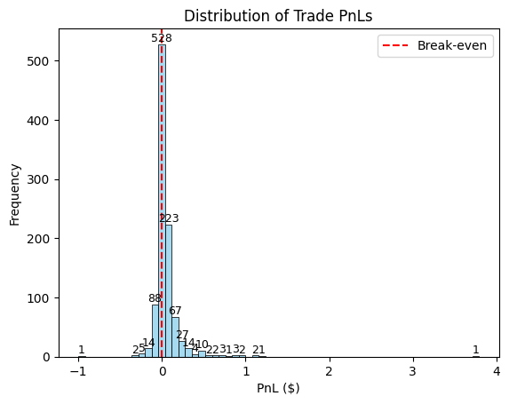
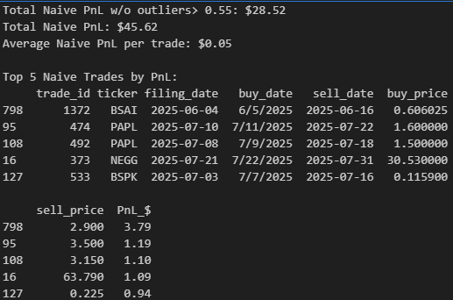
Lvl1-naïve 7d hold if 10dpospredany
Tested on 1000 most recent pred+ non-nan trades w filing_date 5/29/2025-7/22/2025. $1 inv ea
Total PnL: $45.62 Winning trades: 573/1000 → Win %: 57.30%

Slide 9
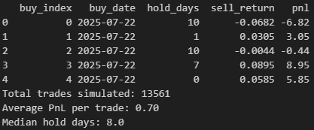
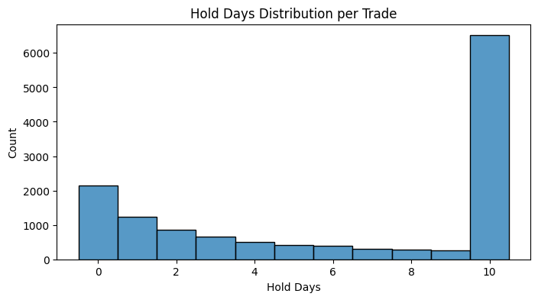
Lvl2 – predpos10d, naive freq-based
GPT hard carry. Going to redo manually cuz it doesn’t work and it can’t be visualized or checked…

